Slide 1

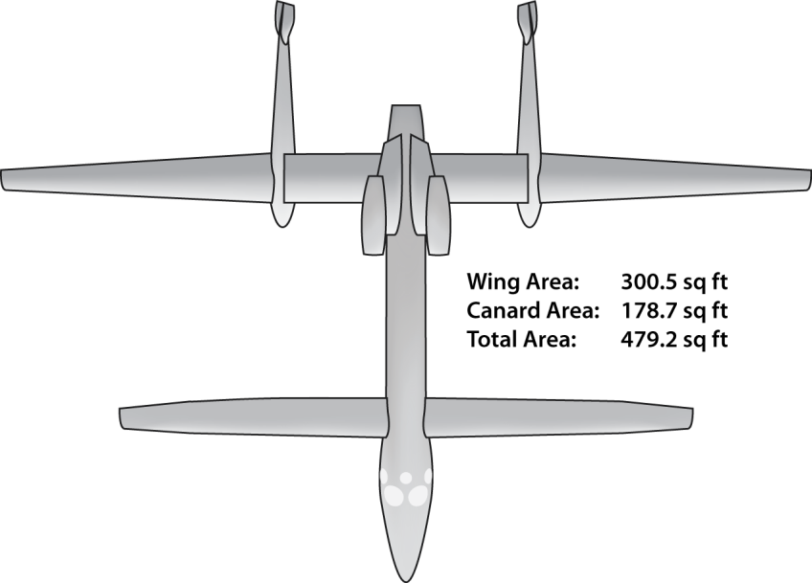
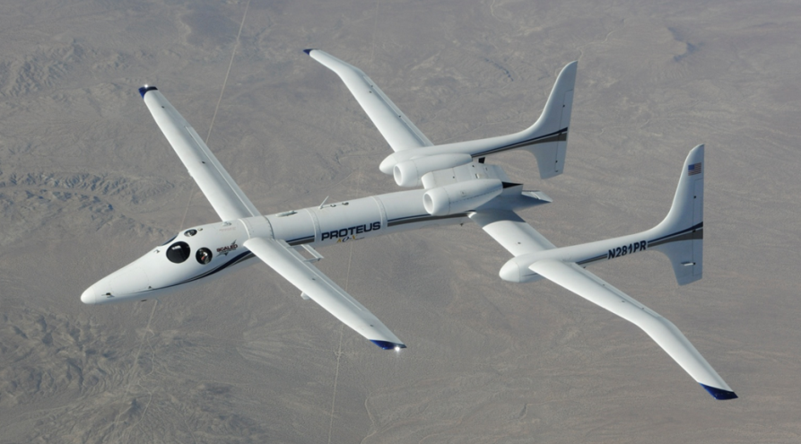
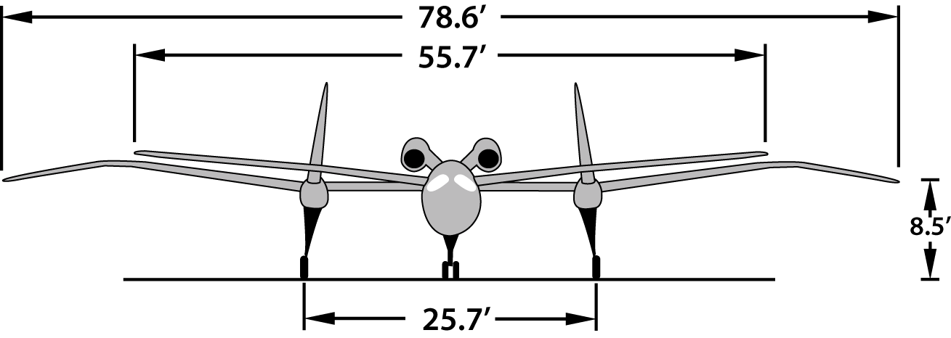
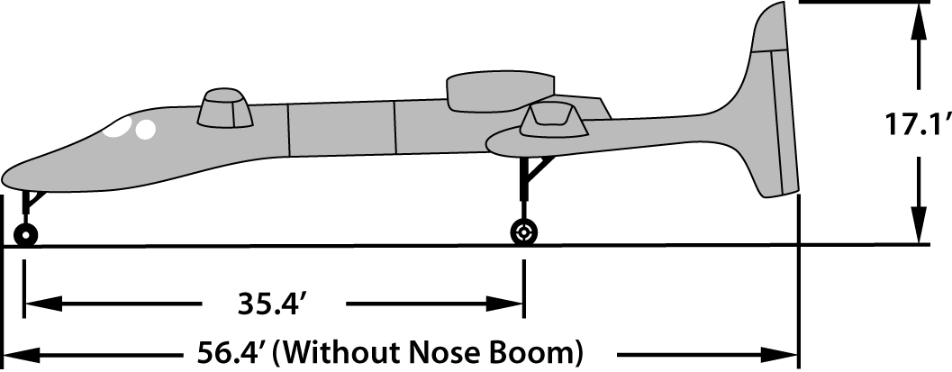
Proven Capabilities
Certification
Experimental – R&D
Maintenance &: Scaled Composites
Weights:
Gross weight: 14,200 lbs
Empty weight: 6910 lbs
Fuel weight (max. possible w/o bladder): 5911 lbs
Max landing weight: 12,500 lbs
Flight Envelope:
Part 23 G loading: +3.2 & -1.8
Vmo=160 <43kft Mmo = 0.6 Ma
Cruise: 125-140kias or 300ktas
Maximum Demonstrated Altitude: 63,245 ft
Service Ceiling w/ 2200lb payload: 56,000 ft
Range: 3125nm (Bangor to Paris)
Demo Max Duration: 12.2 hours

