Slide 1

N520NA Baseline Research Configuration NASA Langley Gulfstream III Aircraft Research Services Directorate NASA Langley Research Center Hampton, VA

Slide 2
Gulfstream III (NASA 520) Aircraft Metrics
Gulfstream III
Serial 478, built in 1986 as U. S. Air Force C-20B
Service Ceiling: 45,000 ft
Max. Gross Weight: 69,700 lbs
Max. Mission Duration: 8.5 hr
Max. Cabin Payload: 2610 lbs
Max. Speed: Mach 0.85
Normal Cruise Range: 3767 n.mi.

Slide 3
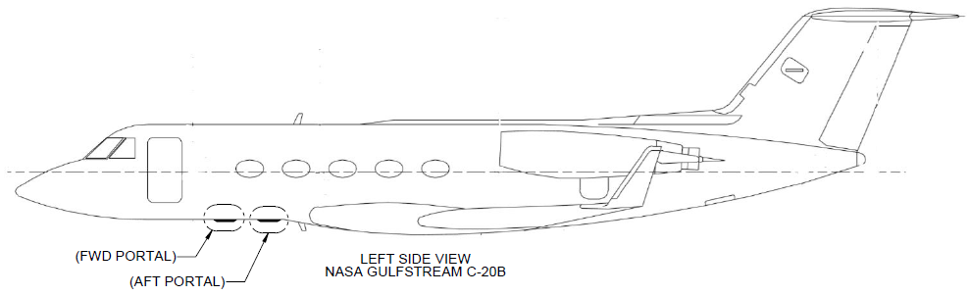
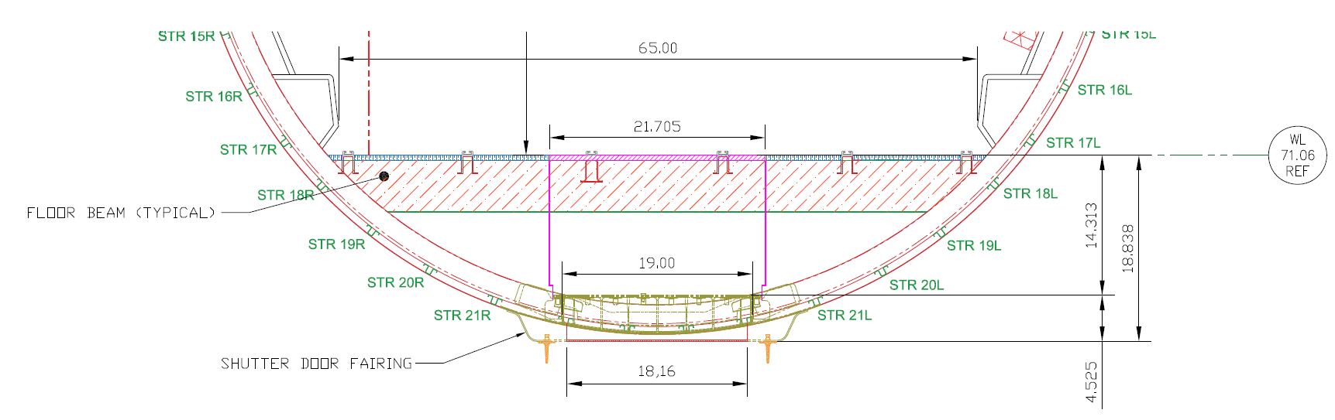
Gulfstream III (NASA 520) Nadir Portal Dimensions
Two Identical Portals
18.16 x 18.16 in. portal “see through” opening
19.00 x 19.00 in. vertical portal flange
21.00 x 21.00 in. mounting flange
Reference:
Portal Instl, NASA Gulfstream C-20B – ICD A028FR20000 Rev B

Slide 4
Gulfstream III (NASA 520) FOD Doors and Associated Fairing (Plan View Looking Up)
Radar Altimeter Antennas
Flow fences (3/8 in. high)
Forward
TCAS
antenna
UHF antenna
FOD shutter doors (18.16 x 18.16 in. each)
ATC and DME antennas (4)

Slide 5
Gulfstream III (NASA 520) Optical Glass
Glass is usually mounted in a “cell”. The maximum diameter cell that can be installed depends on where vertically in the portal it is mounted:
If the cell is located on top of the ring frame upper flange, the cell may be up to 21 in. dia.
If the cell is mounted in the ring frame, between the upper and lower flanges, the cell must be less than 18.75-in. dia.
If the cell is mounted below the ring frame, the glass must be less than 17.91-in. dia.

Slide 6
Gulfstream III (NASA 520) FOD Doors and Associated Fairing
FOD doors protect optical glass installed in portals
Each door operates independently from switches in the cockpit
Each door has a dedicated electric motor
Time to fully open or close is 5 sec
FOD doors translate forward to open
Flow fence located at forward edge of each FOD door portal

Slide 7
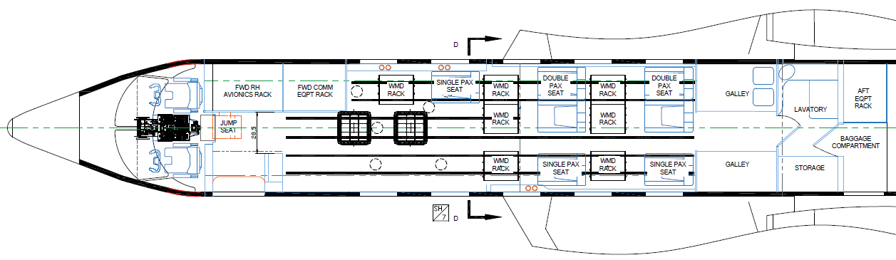
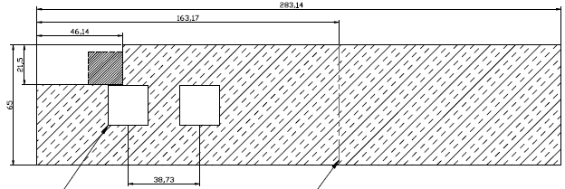
Gulfstream III (NASA 520) Notional Layout and Personnel Arrangement (LOPA)

Slide 8
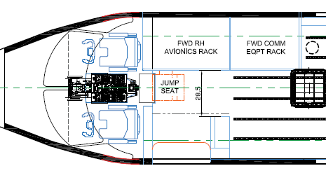

Gulfstream III (NASA 520) Aircraft Access

Slide 9
Gulfstream III (NASA 520) Notional LOPA Description
Example shows accommodations for seven researchers and seven racks; specific LOPA depends on mission requirements
Personnel limit in passenger cabin will be 10
Two identical square nadir portals located in passenger cabin aft of nose gear and forward of wing-to-body fairing
18.16-in. x 18.16-in. opening
Distance between centers of portals is 38.7 in.
Forward entry door is 36 in. wide x 66 in. high
Aisle width aft of passenger door is 28.5 in.
Six Researcher Interface Panels located in passenger cabin, three per side

Slide 10
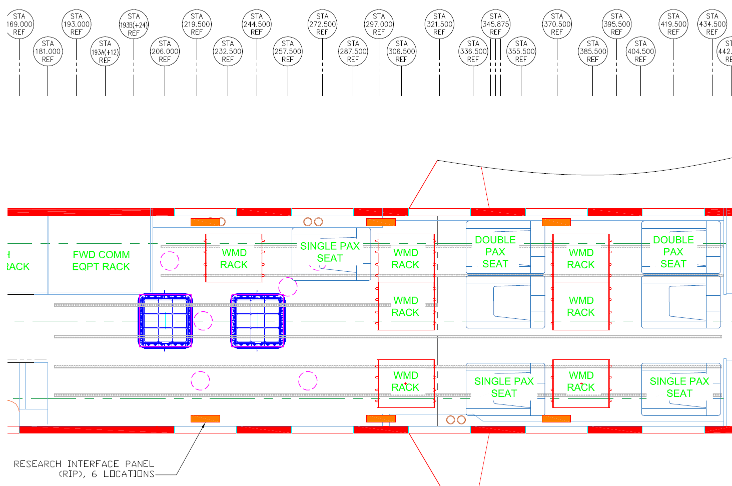
Gulfstream III (NASA 520) Research Power & Data Distribution
Six Researcher Interface Panels will be provisioned at six cabin locations as shown below
Research Interface Panel (6x)

Slide 11
Gulfstream III (NASA 520) Research Power
Research Power Distribution System will present adequate power of various denominations to six cabin research stations.
Total Research Power Capacity
80 A of 120 VAC/60 Hz power
300 A or 28 VDC power
15 A of 14 VDC
20 A of 5 VDC
UPS Override system will be located at each research station and controlled from the Cockpit.

Slide 12
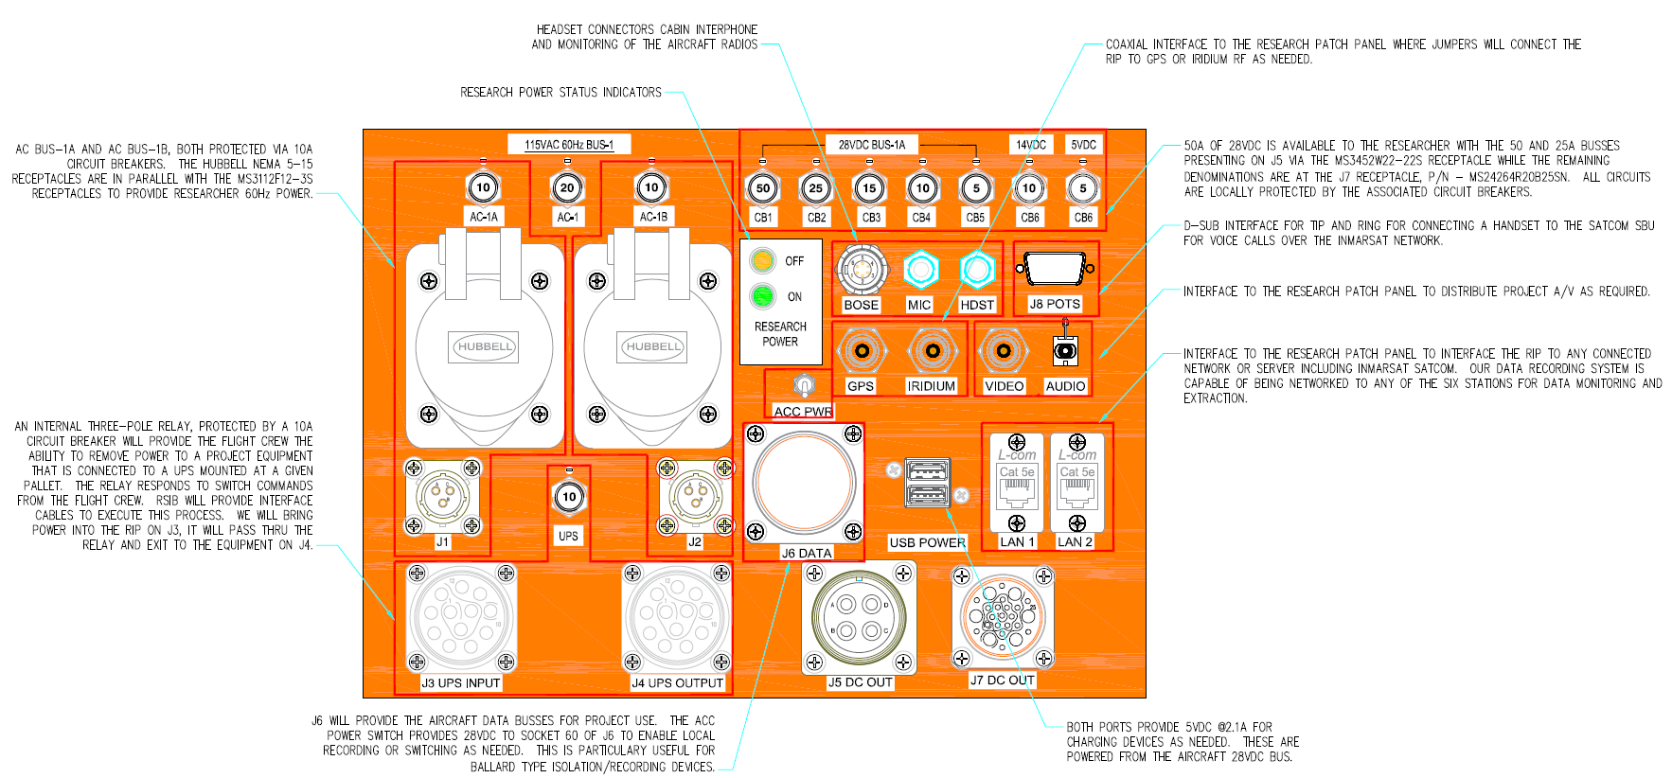
Gulfstream III (NASA 520) Researcher Interface Panel

Slide 13
Gulfstream III (NASA 520) Researcher Interface Panels
Each panel will contain the following capabilities:
Local circuit protection to allow the researcher greater control of the respective system and a quick visual path to identify an open circuit.
Two 10-A NEMA 5-15R receptacles with two 12-3S Mil Spec receptacles in parallel for AC Power delivery (Hubbell and J1).
Mil-Spec connectors provide the user with 50 A of 28 V DC (J5) in addition to 14 and 5 V DC (J7).
Local UPS Override circuitry. An internal relay, controlled by the Cockpit Switch will interrupt up to three 10-A circuits from a researcher’s UPS to downstream equipment (J3 & J4).
Data Bus Traffic (J6)
Bose Headset, Mil-headset and Mil-mic jacks
GPS RF
Iridium RF
Video
Audio
Telephone Handset
USB Power

Slide 14
Gulfstream III (NASA 520) Data Acquisition/Distribution
Aircraft possesses 15 data busses that contain pertinent information that can be used to provide data to researchers, as needed.
Air Data Computer (ARINC 429)
TCAS Processor (ARINC 429)
GDL88 (RS-422 and ARINC 429)
GTX 3000 Transponder (ARINC 429)
GTN750 (ARINC 429 (GAMA) and ARINC 429 (ARINC 743))
NZ-2000 Navigation Computer (FMS) (ARINC 429)
Analog Interface Unit (ARINC 429)
GPA #1 TA-12 (ARINC 429)
Nav Concentrator (ARINC 429)
Symbol Generator #1 (ARINC 419)
Symbol Generator #1 (ARINC 429)
INU Lasernav II (ARINC 429)
Weather Radar RS-861A (ARINC 708)

Slide 15
Gulfstream III (NASA 520) SATCOM Provisions
Iridium
One dual-element antenna installed
One quad-element antenna installed
Resulting six elements can be routed to any Researcher Interface Panel or receiver
One handset (voice + data)
Aviator 350 Inmarsat Swift Broad Band
Four-channel modem on NASDAT
9600 bps max
Bandpass filtering on all Iridium connections as required
Inmarsat
High-gain antenna capable of 432 kbps
Software upgradeable to 650 kbps HDR service (customer-funded option)

Slide 16
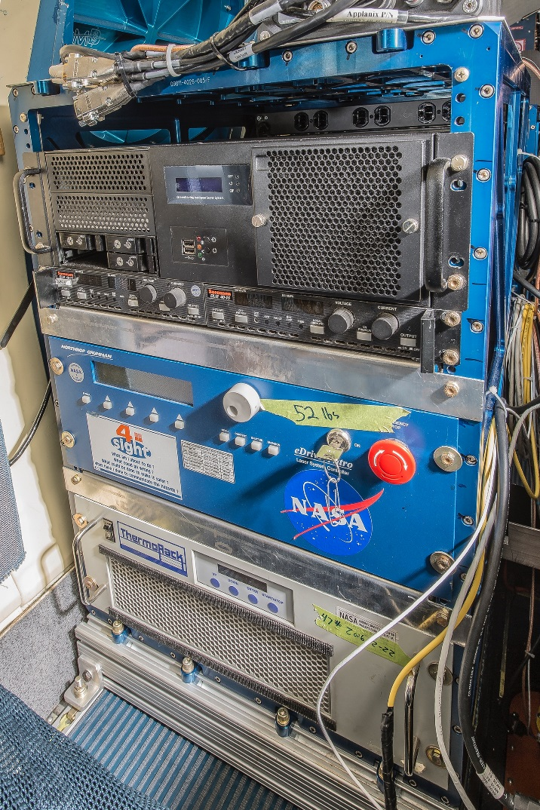
Gulfstream III (NASA 520) Research Rack
Typical COTS 15U research rack shown
24 in. deep x 28.375 in. high x 20.16 in. wide
Compatible with B200, UC-12B, HU-25A and Gulfstream III
Maximum weight: function of overturning moment
Maximum overturning moment: 122,425 in.-lbs
Mounts to seat tracks
May be available for loan from RSD
Researchers can provide their own rack under following conditions:
Material certifications
Design limits
Use of aircraft-grade fasteners
Inspection by LaRC aviation QA for workmanship
Note: 25U (22 W X 25D X 51H) rack for Johnson Gulfstream V can be used, but is too large for other NASA Langley aircraft
15U Rack Populated for Operation IceBridge on HU-25A

Slide 17
Gulfstream III (NASA 520) Compatibility with Other NASA Gulfstream Aircraft
NASA Gulfstream aircraft at NASA Langley, Johnson and Armstrong utilize common load standards and cabin environmental conditions
Equipment racks can be exchanged per slide 16
NASA centers accept design reviews conducted at other centers; for example:
NASA Armstrong has provided NASA Langley with their design for optical window replacement for their Gulfstream III
NASA Johnson has provided NASA Langley with their design for a dropsonde launcher for their Gulfstream III
NASA Armstrong Gulfstream III and NASA Johnson Gulfstream III are both modified to carry the UAVSAR pod
Nadir ports in the NASA Johnson Gulfstream V and the NASA Langley Gulfstream III are not identical; therefore, instrument/aircraft interface structures will be somewhat unique for each vehicle

Slide 18
Gulfstream III (NASA 520) Mission Costs (Full Cost Recovery)
Aircraft Operating Cost (dry and unmanned) = $4200/flight hr in FY19
Fuel
Aircrew labor
Labor for local support of mechanics and avionics technicians
Travel costs
Design, fabrication (including materials), installation (upload), download
Deployment costs (such as hangar rentals, shipping, office rentals, rentals of ground servicing equipment)
Notional deployment team consists of two pilots, two mechanics and mission manager

Slide 19
Gulfstream III (NASA 520) Research Services Directorate Points of Contact
Matthew G. Elder, Head, Research Systems Integration Branch, RSD, and Project Manager for Gulfstream III Initial Operational Capability, matthew.g.elder@nasa.gov
David W. Klassman, Gulfstream III Lead Engineer, david.w.klassman@nasa.gov
Michael S. Wusk, Head, Aircraft Operations and Engineering Branch, RSD, michael.s.wusk@nasa.gov
Bruce D. Fisher, RSD Chief Engineer, bruce.d.fisher@nasa.gov

Slide 20


